Slide 1

INT217 INTRODUCTION TODATA MANAGEMENT
Lecture #0

Slide 2
Course details
LTP – 2 0 2 [Two lectures and Two practicals/week]
Credit – 3

Slide 3
Marks Breakup
Credits : 3
Marks Breakup:
* 2 Best CA out of 3 CA each of 30 marks
* No MTE
* ETE is Practical
Activity | Marks
Attendance | 5
CA | 45
End term Practical(ETP) | 50
Total | 100

Slide 4
Reference Books
Title | Author | Type
FUNDAMENTALS OF BUSINESS ANALYTICS | R.N. PRASAD, SEEMA ACHARYA | Reference Book
EXCEL HACKS,2/ED TIPS & TOOLS FOR STREAMLINING YOUR SPREADSHEETS | DAVID | Reference Book

Slide 5
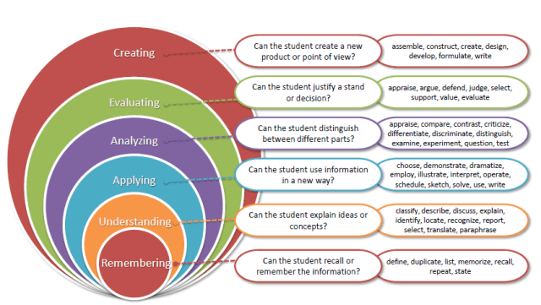
Revised Bloom’s taxonomy

Slide 6
Course outcome
CO1 :: apply the various techniques and functions over spreadsheet for getting various insights of data
CO2 :: practice the data representation methods like pivot table and power pivoting
CO3 :: determining the need of the graphical representation in the spreadsheet by using various graphs and charts
CO4 :: understand the concepts of multidimensional data and topics like OLAP (Online Analytical Processing), OLTP (Online Transactional Processing) and data cube
CO5 :: study the ETL (Extract Transform and Load) process using the SSIS (SQL Server Integration Services) tool and able to perform pre-processing for data analysis
CO6 :: describe effective data management is central to good research practice and identify the benefits of effective data management.

Slide 7
Program Outcomes
PO1 Engineering knowledge:Apply the knowledge of mathematics, science, engineering fundamentals, and an engineering specialization to the solution of complex engineering problems.
PO2 Problem analysis::Identify, formulate, research literature, and analyze complex engineering problems reaching substantiated conclusions using first principles of mathematics, natural sciences, and engineering sciences.
PO3 Design/development of solutions::Design solutions for complex engineering problems and design system components or processes that meet the specified needs with appropriate consideration for the public health and safety, and the cultural, societal, and environmental considerations.
PO4 Conduct investigations of complex problems::Use research-based knowledge and research methods including design of experiments, analysis and interpretation of data, and synthesis of the information to provide valid conclusions.

Slide 8
Program Outcomes
PO5 Modern tool usage::Create, select, and apply appropriate techniques, resources, and modern engineering and IT tools including prediction and modeling to complex engineering activities with an understanding of the limitations.
PO6 The engineer and society::Apply reasoning informed by the contextual knowledge to assess societal, health, safety, legal and cultural issues and the consequent responsibilities relevant to the professional engineering practice.
PO7 Environment and sustainability::Understand the impact of the professional engineering solutions in societal and environmental contexts, and demonstrate the knowledge of, and need for sustainable development.
PO8 Ethics::Apply ethical principles and commit to professional ethics and responsibilities and norms of the engineering practice.

Slide 9
Program Outcomes
PO9 Individual and team work::Function effectively as an individual, and as a member or leader in diverse teams, and in multidisciplinary settings.
PO10 Communication::Communicate effectively on complex engineering activities with the engineering community and with society at large, such as, being able to comprehend and write effective reports and design documentation, make effective presentations, and give and receive clear instructions.
PO11 Project management and finance::Demonstrate knowledge and understanding of the engineering, management principles and apply the same to one’s own work, as a member or a leader in a team, manage projects efficiently in respective disciplines and multidisciplinary environments after consideration of economic and financial factors.
PO12 Life-long learning::Recognize the need for, and have the preparation and ability to engage in independent and life-long learning in the broadest context of technological change.
PO13 Competitive Skills::Ability to compete in national and international technical events and building the competitive spirit alongwith having a good digital footprint.

Slide 10
Course contents
Unit I Spreadsheet functions to organize data : cell reference styles, creating and working with formulas, text functions, date and time functions, lookup and reference functions, mathematical and statistical functions, information and volatile functions, logical and financial functions, formula auditing, error handling, string functions Introduction to Microsoft Excel : UI Basics : introduction to UI basics, about excel, workbooks and worksheets, customizing excel, reference styles, number formatting, custom number formatting, conditional formatting, format as table

Slide 11
Course contents
Unit II Data representation and manipulation : filter, advanced filter for complex criterion, sorting and custom sorting, pivot table and pivot chart, power pivot, import data from different sources into power pivot, reducing file size in power pivoting, connect to multiple different external datasets, DAX functions

Slide 12
Course contents
Unit III Advanced graphing and charting : charts, combo charts, working with objects charts, dynamic charts and dynamic data source for charts print areas, views for a worksheet, various printing techniques
Data protection techniques : worksheet protection, protect specific range, workbook protection
Unit IV Building a model : introduction to building a model, about model and assumptions, diagramming the flow with exercise, wireframing with exercise, preparing the data with exercise, linking up formulas with exercise, sensitivity analysis with exercise, case study: forecasting with a model ction and encryption

Slide 13
Course contents
Unit V Multidimensional data : ETL overview, extracting data, transformations, loading data, simple ETL processing, ETL tools, data sources and destinations, OLTP and OLAP, multidimensional data models, data cube, grouping sets in T-SQL
Unit VI Data Processing using Tableau Prep : introduction to tableau prep, installing tableau prep, basics of data preparation, connecting to data, creating data flow, blend data sources, cross-database join, project task, tableau prep for business

Slide 14
Course contents
Unit VII Introduction to spreadsheets : basic terminology of excel, spreadsheet environment, object model of excel, customizing excel, reference styles, number formatting, custom number formatting, conditional formatting, format as table
ETL processing with SSIS : SQL programming for data science, creating SSIS projects, data wrangling before the load, uploading data, handling errors during ETL, data wrangling after the load, testing and deploying of the project

Slide 15
Next Class: Introduction To Data Management

